Slide 1
Visualization of Sorting Algorithms
B.Tech F.Y.
N2
40 12011121 Kunal Patil
41 12010845 Mandar Patil
42 120110171 Maruti Patil
43 12011336 Niraj Patil
44 12010795 Omkar Patil
45 12010088 Parth Patil
Problem Solving and Programming Course Project
Department of Engineering, Sciences and Humanities (DESH)
Vishwakarma Institute of Technology, Pune
A.Y.(2020-2021) Term II

Slide 2
OUTLINE
Introduction
problem statement
objectives and aim
Background
Implementation
Results and discussion
Conclusion and Future Scope
References

Slide 3
Introduction
A Sorting algorithm is an algorithm that puts elements of a list in a certain order.
The algorithms we covered are: Bubble Sort, Insertion Sort, and Merge Sort
The GUI (Graphical User Interface) is implemented using Tkinter package in python.
Notes:
Niraj

Slide 4
problem statement
To visualize different sorting techniques like insertion sort , bubble sort and quick sort for better understanding and interest of students.
Notes:
Kunal

Slide 5
objectives and aim
objectives
Representing complex sorting process in graphical manner.
Analyzing execution of algorithms.
To increase the learning pace of students.
Providing a experimental approach.
aim
Providing visualized execution of sorting algorithms
Notes:
Maruti

Slide 6
background
Running on normal OUTPUT/TERMINAL Screen
Shows only end result
Can't see the steps
Difficult to understand
Solution:
Showing each step
Using Animation
Delay between each step
Animated videos
Takes lots of effort
Made for fixed array
Can't experiment
Solution:
Auto-changing animation for different arrays
Notes:
Mandar

Slide 7
Implementation
Category of the project
GUI application
Tools / Platform
Python
Pycharm
Tkinter
Front end-Backend Software Requirement
64 bit version of Microsoft windows
Min. 4 GB RAM
1.5 GB Hard Disk
1024x768 min. screen resolution
Latest Python version
Notes:
Kunal

Slide 8
Implementation (Cont.)
Modules / Features
A list of random values within a specified range is generated as bars.
Different colors (red and green) are used to show the sorting process.
A suitable “Speed” range bar is created for the ease of the user to visualize.
“Generate” and “Start” buttons are created separately for the creation of data bars and initiation of the sorting process.
Notes:
Parth

Slide 9
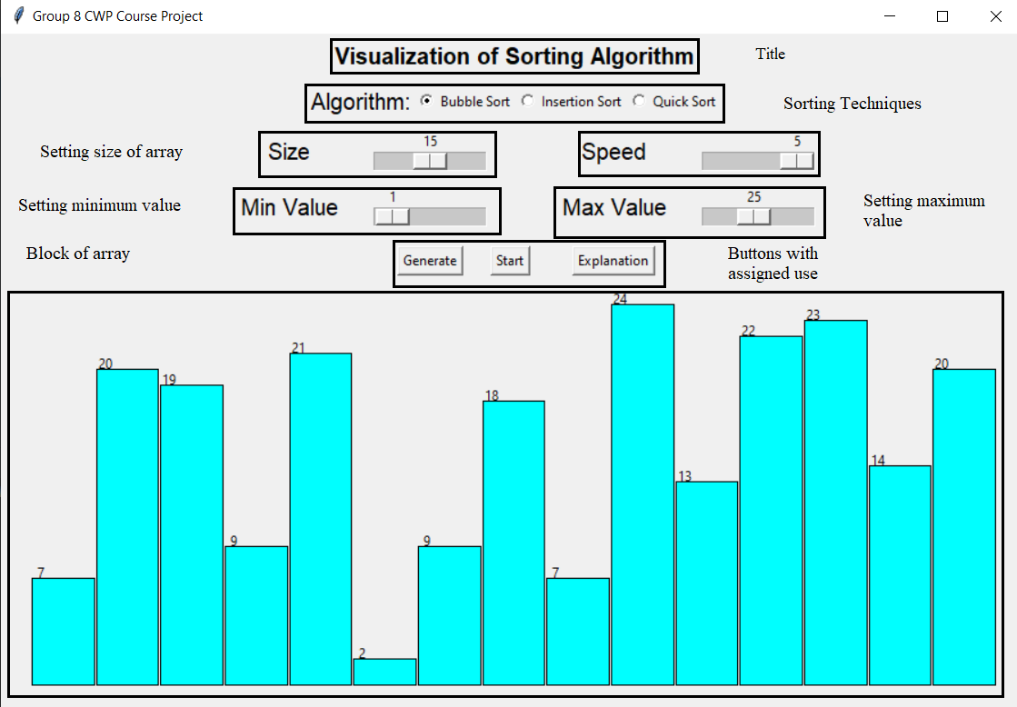
Implementation (Cont.)
System Architecture
GUI
Fig.: 1 Visualization of Sorting Algorithm
Notes:
Omkar

Slide 10
Implementation (Cont.)
Overall Algorithm
Bubble Sort
Bubble Sort also referred as Sinking Sort is a simple sorting algorithm which repeatedly traverses through the data collection.
It focuses on moving larger elements to a particular end.
Insertion Sort
The data collection is virtually split into sorted and an unsorted part.
Values from the unsorted part are picked and placed at the current position in the sorted part.
Best case | Average case | Worst case
N | N² | N²
Best case | Average case | Worst case
N | N² | N²
Notes:
Maruti

Slide 11
Implementation (Cont.)
Overall Algorithm
Quick Sort
Quick Sort is a Divide and Conquer algorithm.
The Key process in Quick Sort is partition function.
Best case | Average case | Worst case
NlogN | NlogN | N²
Notes:
Maruti

Slide 12
Implementation (FLOW-CHART)
START
YES
AT END, WE GOT SORTED ARRAY
TRY AGAIN?
DECIDE THE ALGORITHM TO BE USED
NO
SELECT ARRAY SIZE, MIN. VALUE, MAX. VALUE & SPEED OF ANIMATION
ANIMATION OF SORTING START (BEGIN)
END
UNSORTED ARRAY APPEAR
CLICK ON START
Notes:
Niraj

Slide 13
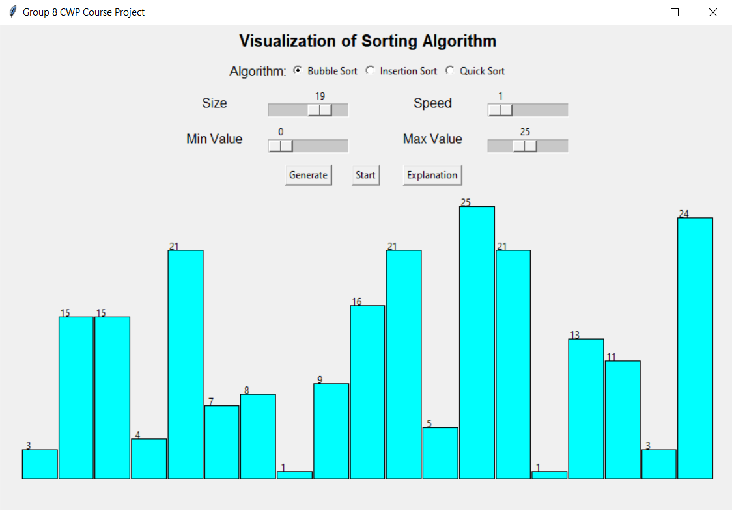
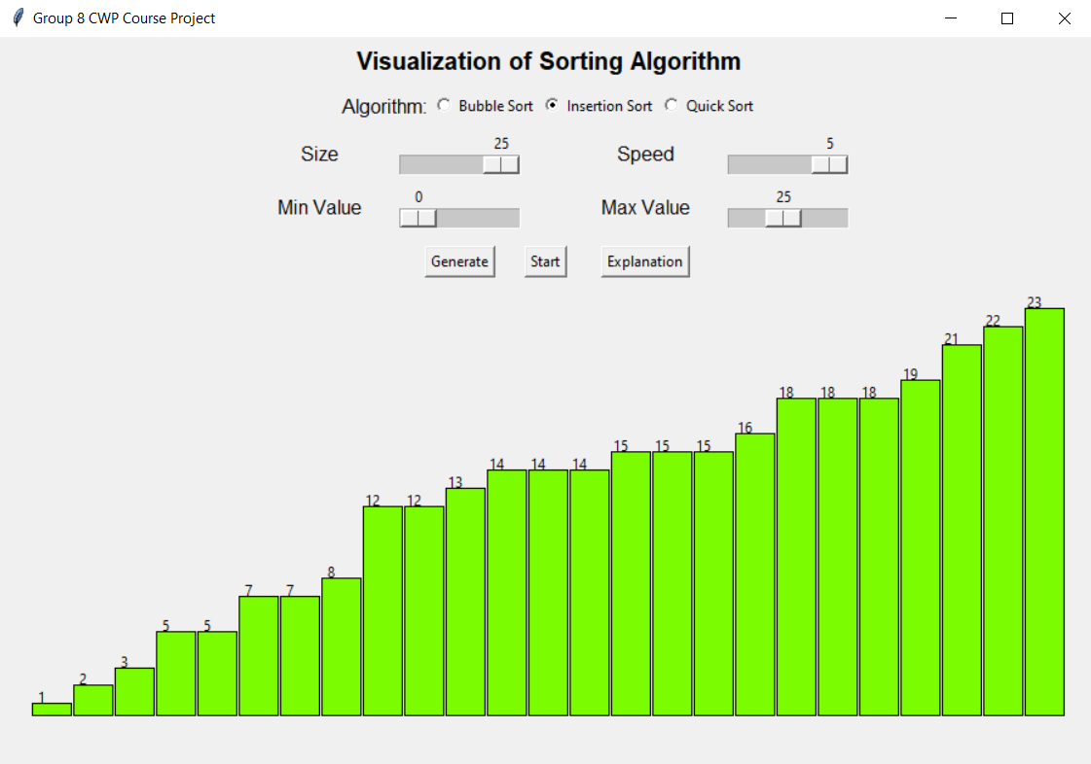
Results and discussion
Fig.: 2
Generating random no. of blocks
Fig.: 3
Results after sorting is complete
Notes:
Omkar

Slide 14
Conclusion and Future Scope
Conclusion
Arranges the elements according to the sorting technique chosen.
Future Scope
Sorting the elements right after the user enters the value of the element.
Notes:
Parth

Slide 15
Contribution
Div N Batch N2
Roll No 40-GRNo- 12011121 –Kunal Patil
Merging of PPT
Learning Tkinter Module
Roll No 41-GRNo- 12010845 –Mandar Patil
Learning Tkinter Module
Coding for design
Roll No 42-GRNo- 12011071 –Maruti Patil
Learning Tkinter Module
Coding for Quick Sort
Roll No 43-GRNo- 12011336 –Niraj Patil
Merging of Report
Learning Tkinter Module
Roll No 44-GRNo- 12010795 –Omkar Patil
Learning Tkinter Module
Coding for Bubble sort
Roll No 45-GRNo- 12010088 –Parth Patil
Learning Tkinter Module
Coding for Insertion Sort

Slide 16
References
https://www.geeksforgeeks.org/python-gui-tkinter/
code with harry’s tkinter tutorial (https://youtube.com/playlist?list=plu0w_9lii9ajlcqrcj4poeihkukf_otza)
https://youtu.be/xglrx34kvj8
https://www.geeksforgeeks.org/bubble-sort/
https://www.geeksforgeeks.org/insertion-sort/
https://www.geeksforgeeks.org/quick-sort/

Slide 17
Thank You

